Slide 1
MEASURING INSTRUMENTS

Slide 2
What is meant by measurement?

Slide 3
Measurement is defined as a process by which one can convert physical parameter to meaningful numbers.

Slide 4
How to measure ???
It involves using an instrument as physical means for determining a quantity or variable.

Slide 5
Essential systems of an Indicating Instrument :-
A deflection system
A controlling system
A damping system

Slide 6
Deflection system
It is that part of the instrument mechanism which utilize some physical effect of electric current or voltage to produce a mechanical force. This deflection or force causes the system along with the pointer attached to it to move from it’s zero position.
The magnetude of the deflection force(deflection of pointer) depents on the value of electrical quantity to be measured.

Slide 7
Controlling system
It is that part of the instrument which brings into play a force called controlling force. This force opposes the deflection force and increases with the increase in the deflection of the moving system, to limit its movement.
The pointer is brought to rest at a position where the two opposing forces i.e. deflection and controlling forces are equal.
Types of controlling system
Spring control
Gravity control

Slide 8
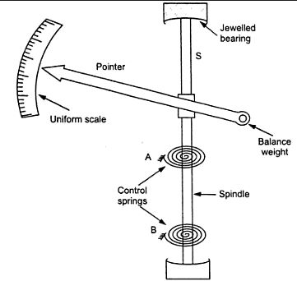
Spring control

Slide 9
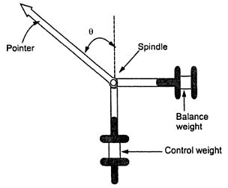
Gravity control

Slide 10
Damping system
It is that part of the instrument which provides damping force to damp the oscillations of the pointer before come to a rest.
Because of the inertia, the pointer of the instrument oscillate about its final deflected position for some time before coming to rest. This causes the waste of time in taking reading, thus damping force act as a brake to prevent the oscillations of the moving system and brings the pointer to it’s final deflected position quickly.
There are three types of damping instruments:
1.Critical damping- Pointer rises quickly to its final position without oscillation.

Slide 11
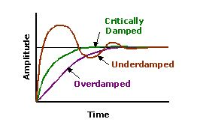
2.Under damping- oscillations of the system will not be completely preventated.
3.Over damping: In this the response of the system is slow and lethargic.
Damping curves

Slide 12
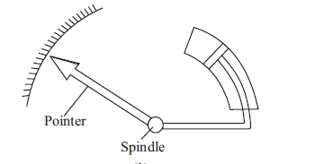
Common Methods of damping:
Air friction or pneumatic damping
Eddy current or electromagnetic damping
Air friction or pneumatic damping:

Slide 13
Air Friction or Pneumatic Damping:
In this system a light aluminum piston is attached to the spindle of the instrument and is arranged to move in a fix air chamber closed at one end. The cross section of the chamber may be either circular or rectangular and the clearance between the piston and the side of the chamber is small and uniform. Compression and suction action of the piston on the air in the chamber damp the possible oscillations of moving system, because the motion of the piston in either direction is oppose by the air.

Slide 14
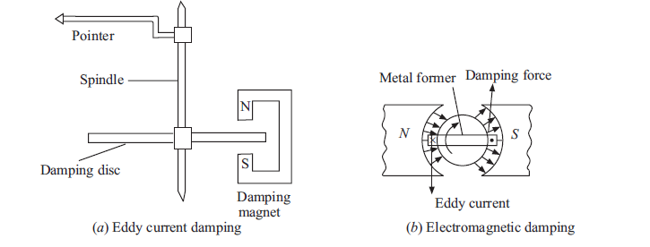
Eddy current damping:

Slide 15
Eddy current damping:
It is the most efficient type of the damping
In this a thin disc usually of copper or aluminum is mounted on the spindle. When this disc moves in the magnetic field of permanent magnet, line of force are cut and eddy current are set up in it.
The force that exists between these current and magnetic field is always in the direction opposing the motion and therefore, provide necessary damping.
The magnitude of the induce current and therefore of the damping force which is dependent on it, is directly proportional to the velocity of moving system.

Slide 16
Permanent magnet moving coil Instruments:- (PMMC)

Slide 17
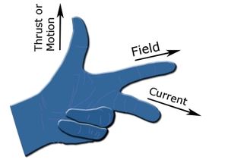
PMMC………….
Principle of Operation: When a current carrying conductor is placed in a magnetic field, it experiences a force and tends to move in the direction as per Fleming’s left hand rule. Fleming left hand rule: If the first and the second finger and the thumb of the left hand are held so that they are at right angle to each other, then the thumb shows the direction of the force on the conductor, the first finger points towards the direction of the magnetic field and the second finger shows the direction of the current in the wire.

Slide 18
Construction:
A coil of thin wire is mounted on an aluminum frame (spindle) positioned between the poles of a U shaped permanent magnet which is made up of magnetic alloys like alnico.
The coil is pivoted on the jewelled bearing and thus the coil is free to rotate. The current is fed to the coil through spiral springs which are two in numbers. The coil which carries a current, which is to be measured, moves in a strong magnetic field produced by a permanent magnet and a pointer is attached to the spindle which shows the measured value.

Slide 19
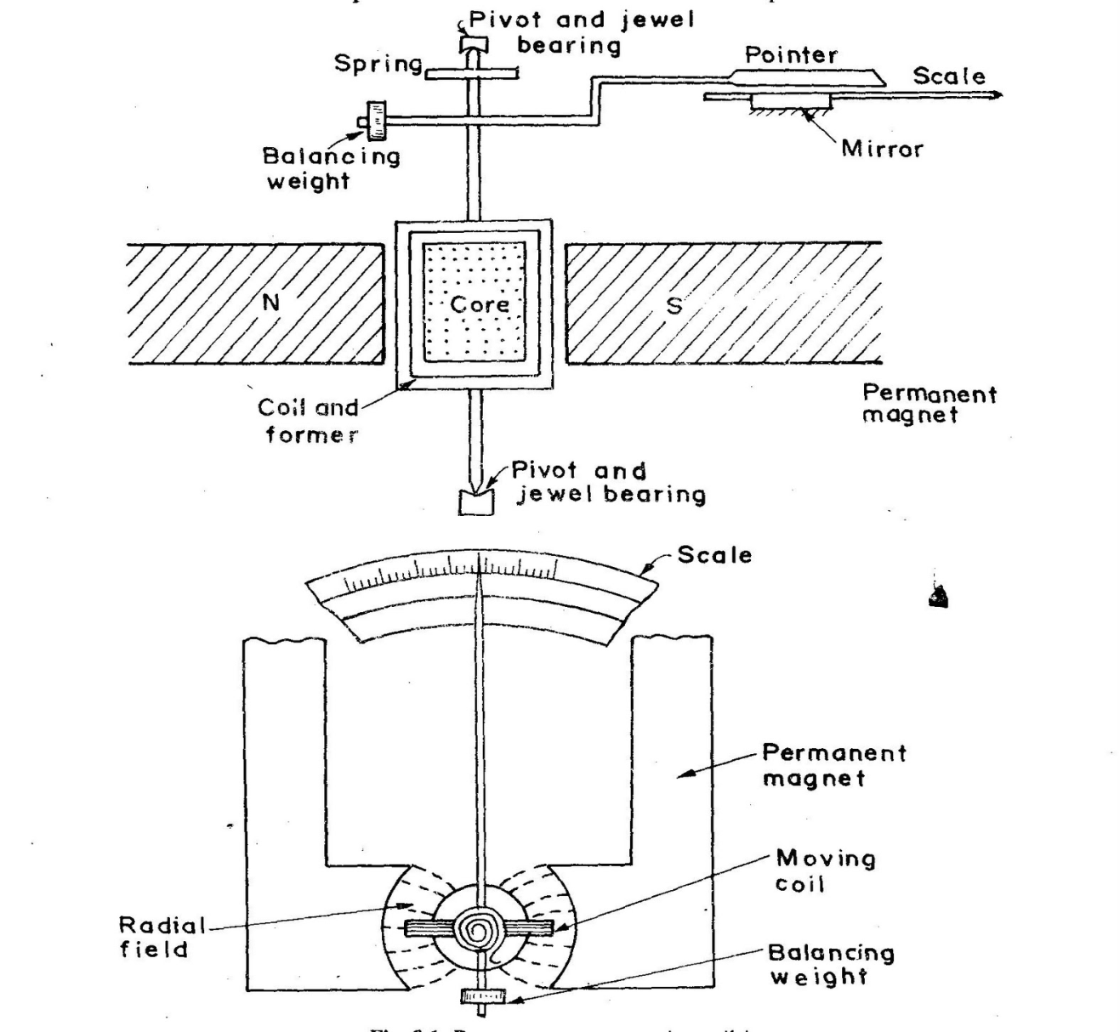

Slide 20
Working:
When a current flow through the coil, it generates a magnetic field which is proportional to the current in case of an ammeter. The deflecting torque is produced by the electromagnetic action of the current in the coil and the magnetic field.
The controlling torque is provided by two phosphorous bronze flat coiled helical springs. These springs serve as a flexible connection to the coil conductors.
Damping is caused by the eddy current set up in the aluminum coil which prevents the oscillation of the coil.

Slide 21
Applications:
The PMMC has a variety of uses onboard ship. It can be used as:
Ammeter:
When PMMC is used as an ammeter, except for a very small current range, the moving coil is connected across a suitable low resistance shunt, so that only small part of the main current flows through the coil.

Slide 22
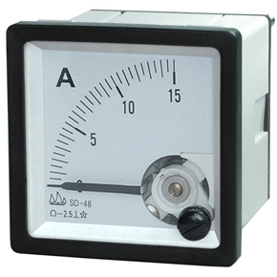
Ammeter

Slide 23
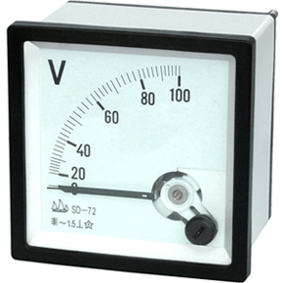
Voltmeter:
When PMMC is used as a voltmeter, the coil is connected in series with high resistance. Rest of the function is same as above. The same moving coil can be used as an ammeter or voltmeter with an interchange of above arrangement

Slide 24
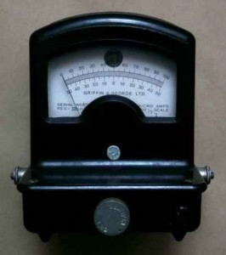
Galvanometer:
Galvanometer is used to measure small value of current along with its direction and strength. It is mainly used onboard to detect and compare different circuits in a system

Slide 25
Advantages:
The PMMC consumes less power and has great accuracy.
It can be modified as ammeter or voltmeter with suitable resistance.

Slide 26
Disadvantage:
The moving coil instrument can only be used on D.C supply as the reversal of current produces reversal of torque on the coil.
It’s costly as compared to moving coil iron instruments.
It may show error due to loss of magnetism of permanent magnet.

Slide 27
Moving Iron Instruments :- (MI)

Slide 28
Construction and basic principle operation of Moving - Iron instruments
Moving-iron instruments are generally used to measure alternating voltages and currents. In moving-iron instruments the movable system consists of one or more pieces of specially-shaped soft iron, which are so pivoted as to be acted upon by the magnetic field produced by the current in coil.

Slide 29
Construction:
Moving element: a small piece of soft iron in the form of a vane or rod.
Coil: to produce the magnetic field due to current flowing through it and also to magnetize the iron pieces.
Control torque is provided by spring or weight (gravity).
Damping torque is normally pneumatic, the damping device consisting of an air chamber and a moving vane attached to the instrument spindle.
Deflecting torque produces a movement on an aluminum pointer over a graduated scale.

Slide 30
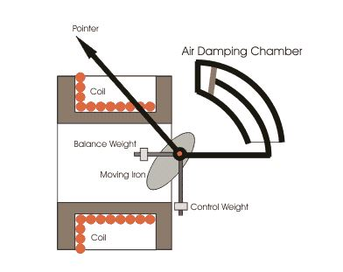
Diagram:

Slide 31
Working:
The current flow through the stationary coil produces the magnetic field which attracts the iron vane. The iron vane deflects from the low magnetic field to the high magnetic field, and the strength of the deflection is directly proportional to the magnitude of the current flowing through the coil. In short, we can say that the iron coil is attracted towards the electromagnet.
The attraction type instruments use spring, which provided the controlling torque.

Slide 32
Application:
Measurement of Electric Voltage and Current
Moving iron instruments are used as Voltmeter and Ammeter only.
Both can work on AC as well as on DC.
Ammeter:
Instrument used to measure current in the circuit.
Always connected in series with the circuit and carries the current to be measured.
This current flowing through the coil produces the desired deflecting torque.
It should have low resistance as it is to be connected in series.

Slide 33
Voltmeter
Instrument used to measure voltage between two points in a circuit.
Always connected in parallel.
Current flowing through the operating coil of the meter produces deflecting torque.
It should have high resistance. Thus a high resistance of order of kilo ohms is connected in series with the coil of the instrument

Slide 34
Advantages:
The instruments are suitable for use in AC and DC circuits.
The instruments are robust, owing to the simple construction of the moving parts.
The stationary parts of the instruments are also simple.
Instrument is low cost compared to moving coil instrument.

Slide 35
Induction Type Energy Meter

Slide 36
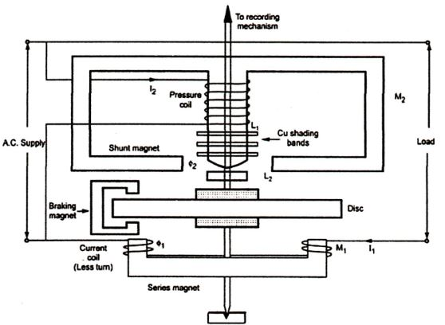

Slide 37
Single phase induction type energy meter is also popularly known as watt-hour meter.
Induction type energy meter essentially consists of following components:
1. Driving system 2. Moving system 3. Braking system 4. Registering system

Slide 38
Driving System: Driving system consists of two electromagnets on which pressure coil and current coils are wounded, as shown above in the diagram. The coil which consisted of load current is called current coil while coil which is in parallel with the supply voltage (i.e. voltage across the coil is same as the supply voltage) is called pressure coil. Shading bands are wounded on as shown above in the diagram so as to make angle between the flux and and applied voltage equal to 90 degrees.
Moving System: In order to reduce friction to greater extent floating shaft energy meter is used, the friction is reduced to greater extinct because the rotating disc which is made up of very light material like aluminium is not in contact with any of the surface. It floats in the air. One question must be arise in our mind is that how the aluminium disc float in the air? To answer this question we need to see the constructional details of this special disc, actually it consists of small magnets on both upper and lower surfaces. The upper magnet is attracted to an electromagnet in upper bearing while the lower surface magnet also attracts towards the lower bearing magnet, hence due to these opposite forces the light rotating aluminium disc floats.
Braking System: A permanent magnet is used to produce breaking torque in single phase induction energy meters which are positioned near the corner of the aluminium disc.
Counting System: Numbers marked on the meter are proportion to the revolutions made by the aluminium disc, the main function of this system is to record the number of revolutions made by the aluminium disc.

